Slide 1
Smart Soles
Group: Tai-Chi
Team Leader: Riley Sherwood
Engineers: Josh Gogolin, Aaron Lim, Scott Murray
CSE408
Spring 2020

Slide 2
OUTLINE
Motivations
Overview/ Goal
Schedule
Gantt Chart
Change of Scope (Covid -19)
Design
Equipment/ Cost
How does it work?
Implementation
Piezoelectric Sensors
Simulation Circuit
Code
Prototype
Current State
Demo
Challenges
Enhancements
Acknowledgments
Q & A

Slide 3
Motivations - Overview / Goal
Purpose:
Create a small portable system to measure gait and balance. Our measurements will provide an 80% or better accuracy as compared to the gold standard.
Reason:
Client is using a heavy piece of machinery to measure balance in an individual. It’s weight is too heavy to be carried by one to two people and its size is massive as well. It isn’t as portable as our client would like it to be, but it is accurate. Another device is used entirely for gait analysis. So to measure gait and balance in one session is ideal. Portability was the main issue here and we solved that problem with our proposed design for smart insoles.
Design Goals:
Accurately measure a gait and balance performance test on a smaller more mobile device than what is currently in use.

Slide 4
Motivations - (Schedule)
Design Activity | Date Complete
System Design | Jan 23
Main Circuit | May 20
Power Supply | May 27
Integrate and Test | June 3
Final Product | June 3

Slide 5
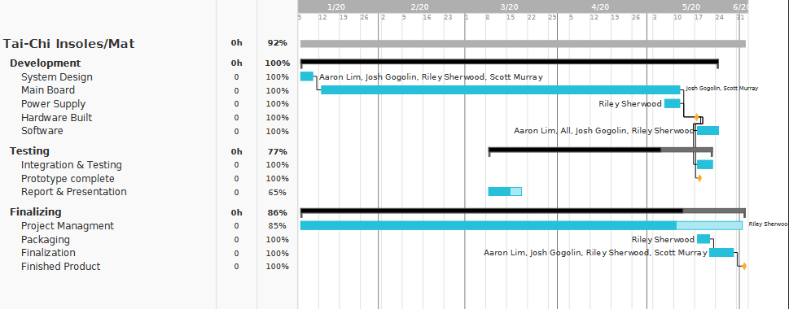
Motivations - (Gantt Chart)

Slide 6
Change of Scope For Covid-19
Original | Changes | Why?
Order parts as needed | Work with mostly what we have in stock | Shipping times are delayed up to over a month due to pandemic
Use of Strain Gauges | Piezoelectric Sensors | Less Fragile & Works
Use of two feet | one foot | Eliminate any hardware difficulty with synching the feet for measurements & eliminate purchasing more parts
Compare old tests to determine improvements in balance (i.e. From a database) | Pushed to a possible added function once all other functions are completed | Time constraints
Gyroscope | Eliminated | Part availability due to Covid-19 & Time Constraints
Power indicator | Eliminated | Part availability due to Covid-19 & Time Constraints

Slide 7
Design (Equipment / Cost)
Piezoelectric Sensors (Qty: 12) : $8.99
Insole/foam sandal: $2
Canakit Raspberry Pi 4 - 4GB basic Starter Kit with Fan(ASIN: B07VYC6S56): (Qty:1) $83.00
ELEGOO Upgraded Electronics Fun Kit w/Power Supply Module, Jumper Wire, Precision Potentiometer, 830 tie-Points Breadboard for Arduino, STM32(ASIN:B01ERPEMAC) : $20
E-Projects 100EP512100R 100 Ohm Resistors, 1/2 W, 5% (Pack of 100) (ASIN: B0185FIDDW) $6.00
(A2D) MCP3008 - 8-Channel 10-Bit ADC With SPI Interface- 4pack (ASIN: B01HGCSGXM) (Qty: 2) $25.00
Elegoo EL-CP-004 120pcs Multicolored Dupont Wire 40pin Male to Female, 40pin Male to Male, 40pin Female to Female Breadboard Jumper Wires Ribbon Cables Kit (ASIN: B01EV70C78) (Qty: 1) $7.00
Total: $151.99
Est Total on completion (Both soles): $300, or less.

Slide 8
Design (How does it work?)
- The sandal holds sensors around the outer edge when pressed the sensors discharge a small voltage. This discharged voltage is then measured to determine how hard the sensor was depressed.
-- The code reads each channel to determine the voltage changes on a specific sensor.
- The voltage is measured and compared to each other sensor in order to show where the most pressure is being applied.
-This data is displayed on a scatter plot displaying different sensitivities so that the user can see how pressure from the patient’s feet is being applied. This will allow the user to perform balance tests with real-time data.
- Data is displayed real-time in the Tkinter GUI and results are output into a .crv file

Slide 9
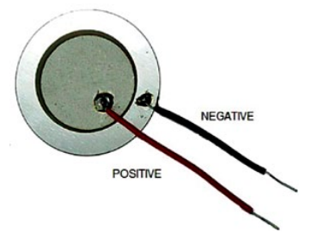
Implementation (Sensors)
Piezoelectric Sensors
Piezoelectric sensors are sensors that when depressed discharge electricity.
These sensors are made from piezoelectric materials which discharge stored electricity when under duress.
We can use this effect to measure the voltage the sensors output and convert that value into a measure of pressure used for balance analysis.
Because these piezo sensors are outputting a relatively small voltage we are using high value resistors in a voltage divider this way our current is not diminished.

Slide 10
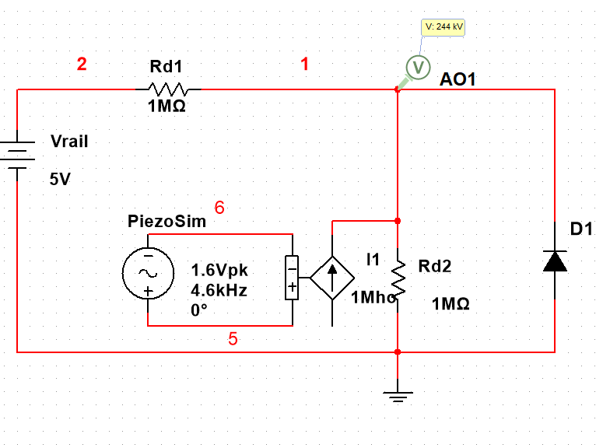
Single Piezo Sensor Simulation

Slide 11
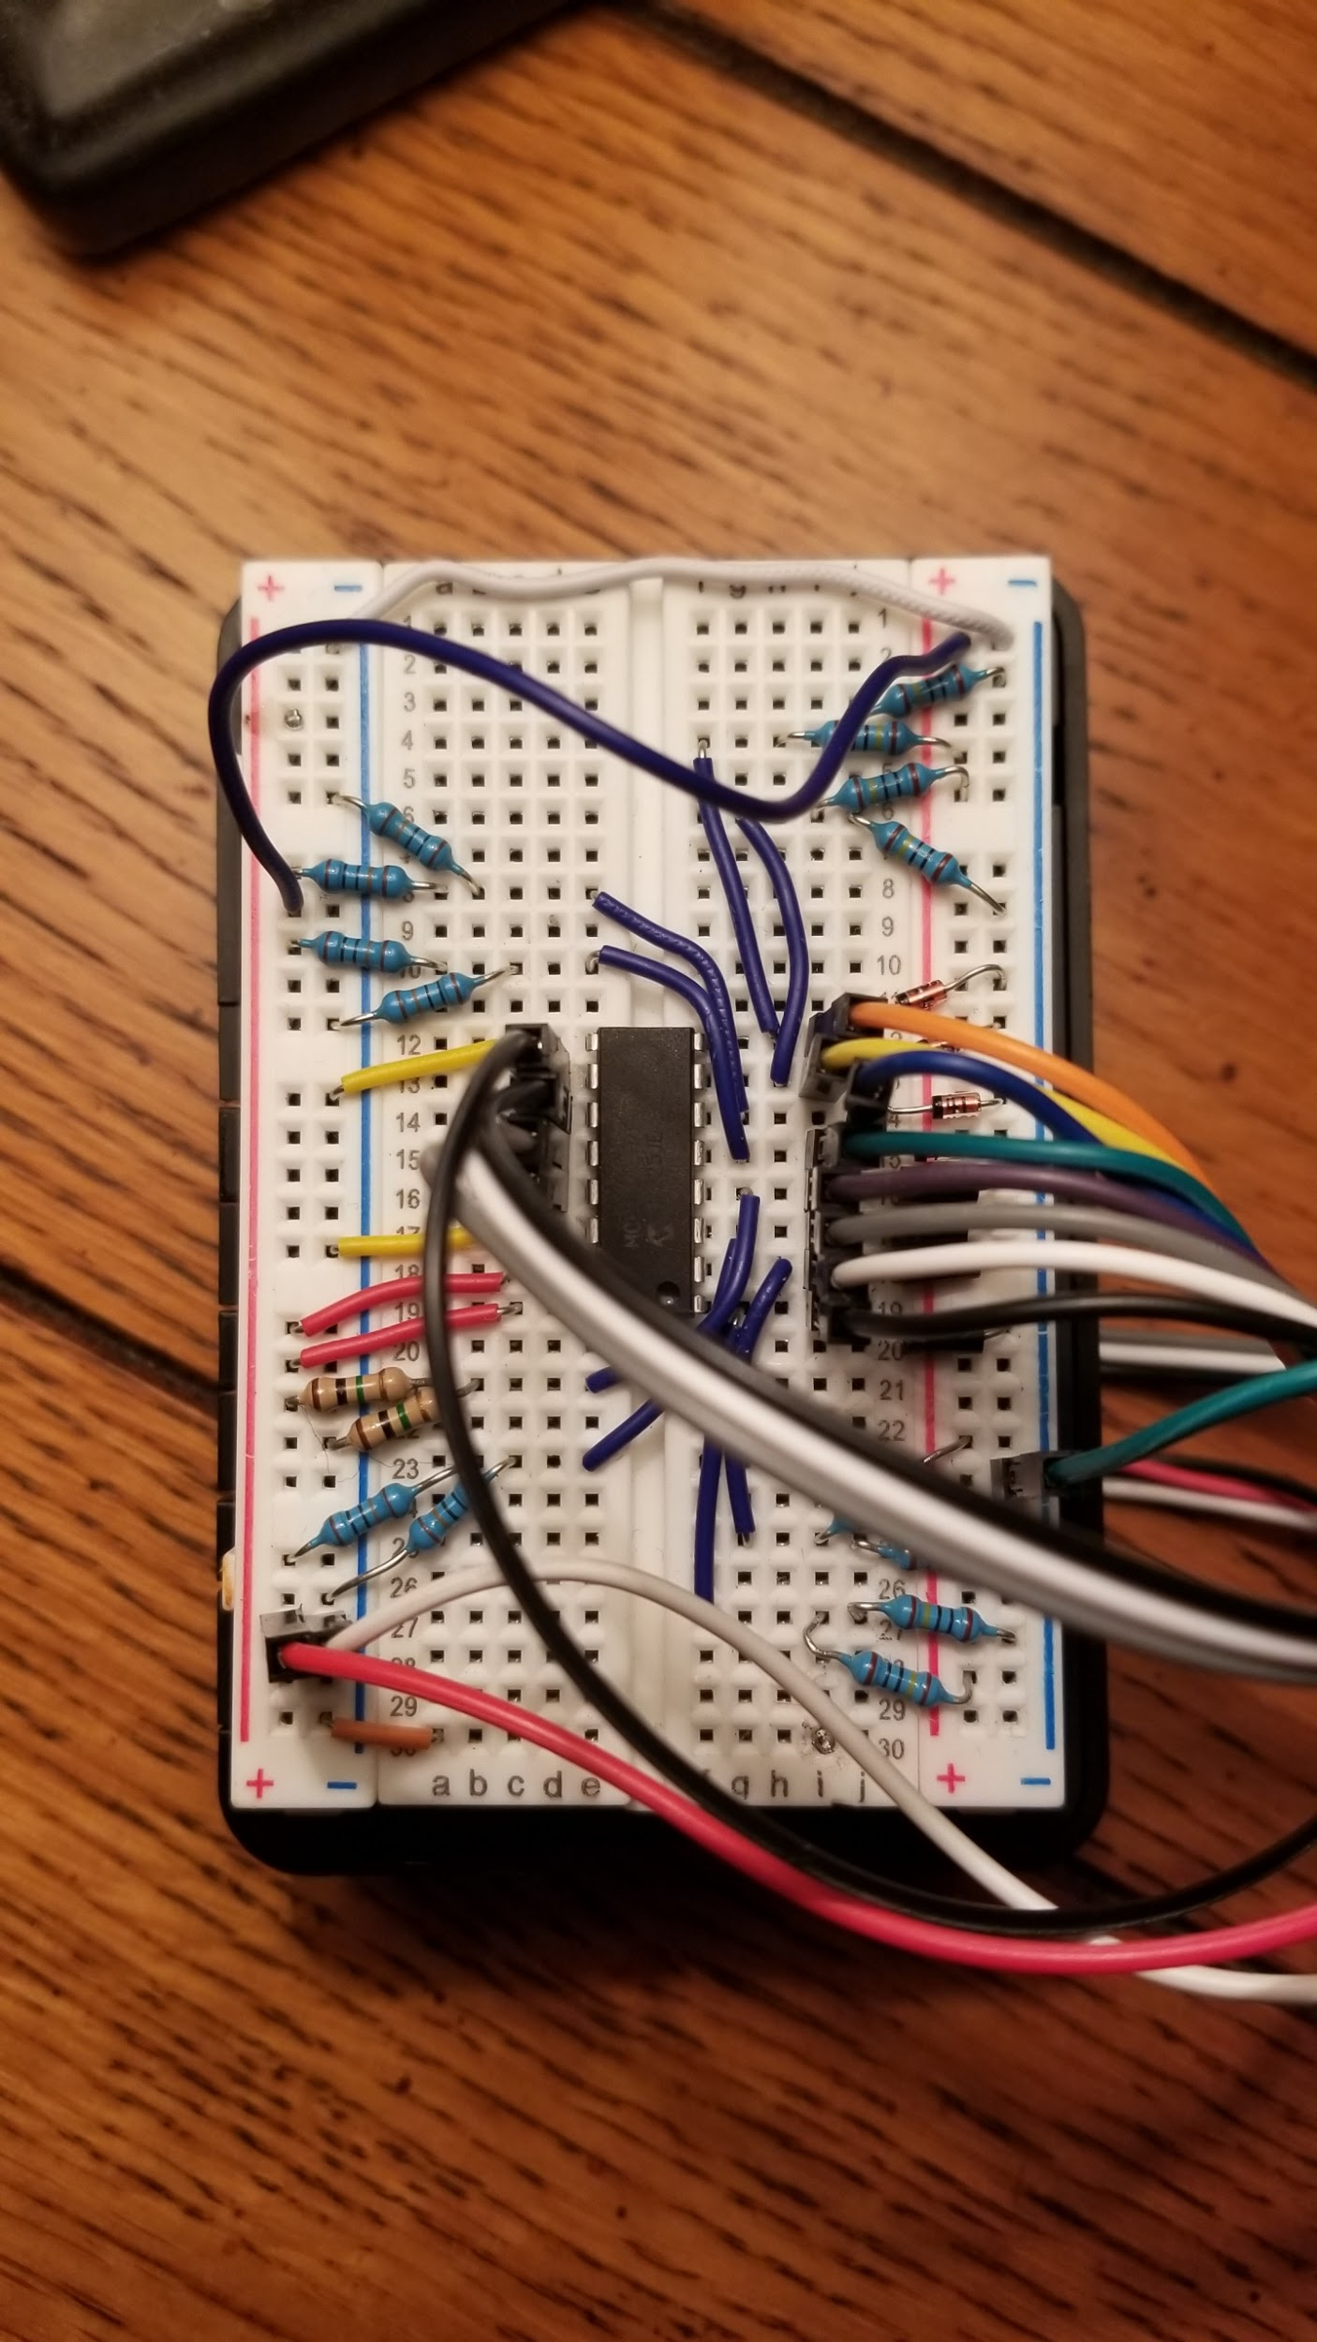
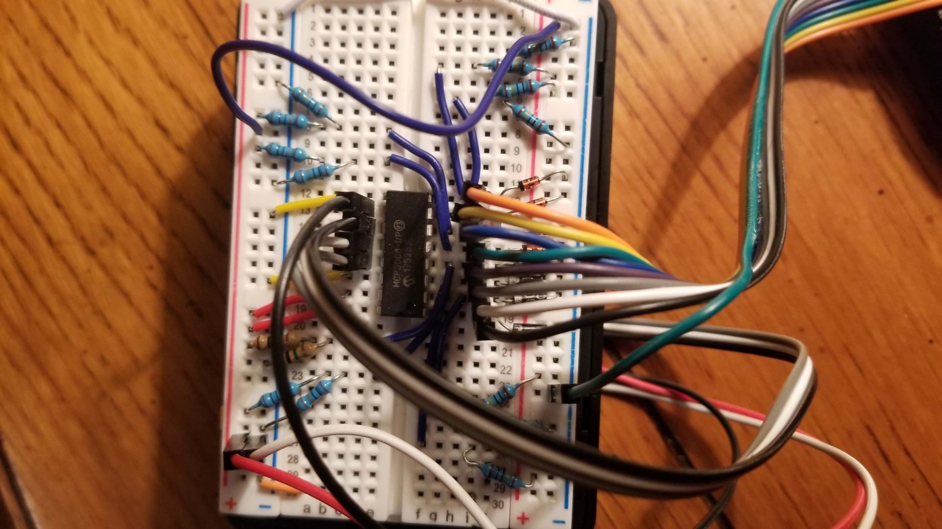
Piezoelectric Sensor Circuit
Notes:
8 Piezos on the breadboard

Slide 12
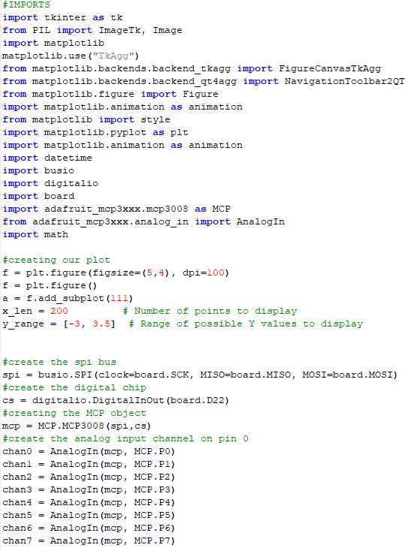
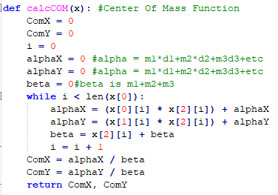
Center Of Mass
Initialization

Slide 13
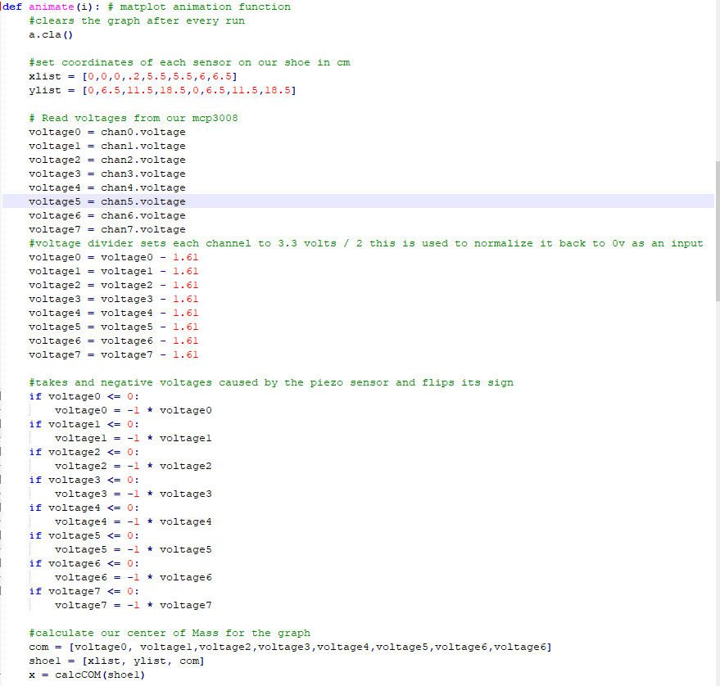
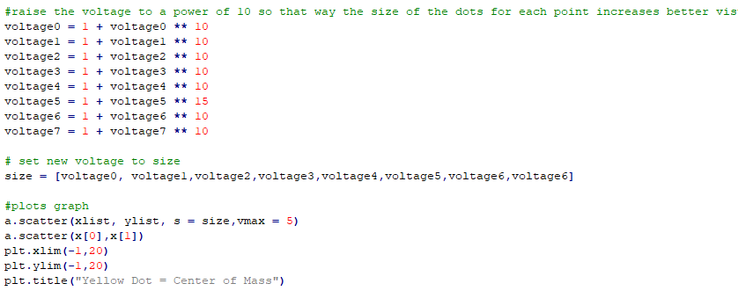
Animation Function

Slide 14
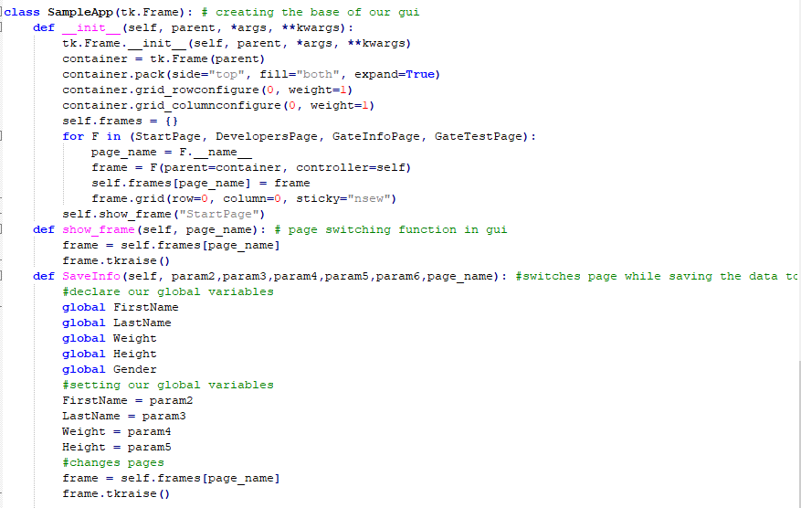
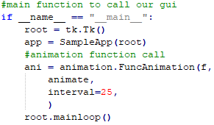
Gui Base / Changing Pages / Saving Info / Main

Slide 15
Design Challenges
Equipment Availability (Soldering kit, more sensors, laptop/mobile device)
Forced to work with what we had, as acquiring more parts became difficult.
Most components shipped from China, which post March, shipping costs and delays became astronomical.
Cost (Engineers were either furloughed or laid off)
Unable to meet as a group for hardware implementation (Social distancing)
Campus resources were unavailable

Slide 16
Future Design Enhancements
Database (To store old data for data comparison for clients )
Implementation of a two insole test
Implementation of a gyroscope
Implementation of a power light indicator
Cleaner, more appealing app design with a 3d printed custom sole
Better accuracy in tests (i.e. More precision)
Battery for device portability

Slide 17
Acknowledgements
Dr. Fadi Muheidat for being an amazing and caring professor
CSUSB for not cancelling the Spring2020 Quarter
Multisim
https://en.wikipedia.org/wiki/Piezoelectricity#Mechanism
“Flexible Insole Sensors with Stably Connected Electrodes for Gait Phase Detection” (Research Paper)
Christian Espsito at Tekscan(source for similar products)

Slide 18
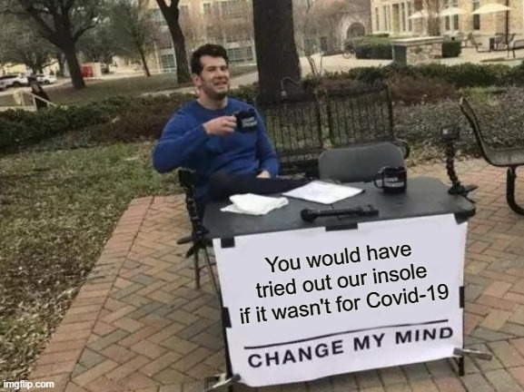
Questions Anyone?

Slide 19
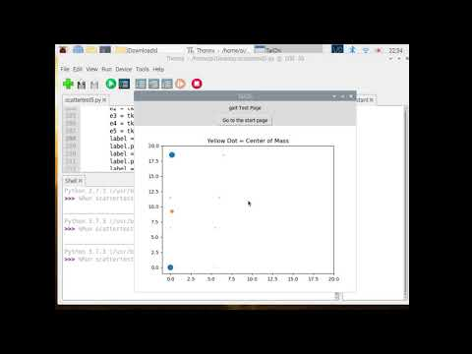
DEMO

